Slide 1

Engineering Scalable Systems: The Core Principles of LLD and SOLID
Seminar
Seminar Guide:
Dr. Brijendra Singh
Associate Professor
Presented by:
Prabhu Teja Pamula
24EMCA1237
Final Review
30 June 2026

Slide 2
Outline
Phase 1:
Architectural Assessment & Problem Domain
The Phenomenon of Software Rot: Degradation Metrics in Production Environments.
Structural Code Failures: Mechanics of Fragility, Rigidity and High Coupling Cascades.
System Boundaries: Delineating High Level Design (HLD) Topology from Low Level Design (LLD) Components.

Slide 3
Outline
Phase 2:
The Foundational Layer (The OOP to SOLID Transition)
The Paradox of Object Oriented Programming: How Misused Inheritance and Encapsulation Drive Rigidity.
Design Smells: Technical Indicators of Component Inelasticity and Immobility.

Slide 4
Outline
Phase 3:
The SOLID Engineering Framework
Single Responsibility Principle (SRP): Designing High Cohesion and Single Reasons to Change.
Open/Closed Principle (OCP): Abstraction Layers and Extension Vectors.
Liskov Substitution Principle (LSP): Subtyping Contracts and Behavioral Invariance.
Interface Segregation Principle (ISP): Lean Contracts vs. Fat Interface Anti Patterns.
Dependency Inversion Principle (DIP): Component Decoupling & Dependency Injection Mechanics.

Slide 5
Outline
Phase 4:
Design Patterns & Real World Validation
Creational Blueprints: Factory Method Implementation Logic & Object Instantiation Decoupling.
Behavioral Blueprints: Strategy Pattern for Runtime Algorithm Interchangeability.
Enterprise Case Studies: Bridging Academic MCA Coding to Production Ready Systems
Seminar Synthesis: Key Technical Takeaways & Reference Verification.

Slide 6
Phase 1
Architectural Assessment & Problem Domain

Slide 7
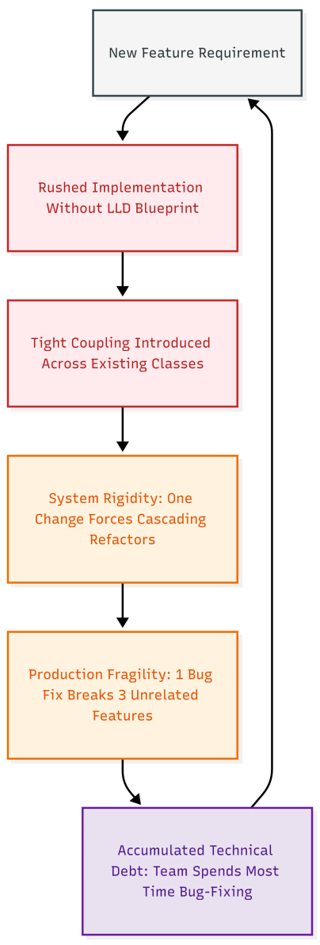
The Phenomenon of Software Rot
The Working Code Trap
Just because code compiles and passes its current tests does not mean it is high quality.
Real success means the code is clean enough for another developer to safely modify it next month without triggering unexpected system failures.
Focusing only on quick results creates hidden traps that make future development impossible.
Why Code Automatically Rots
Tight deadlines and pressure force developers to write quick, messy fixes rather than clean architectures.
Skipping proper low level design blueprints causes code quality to drop continuously over time.
Rushing a feature out the door without refactoring leaves behind permanent structural flaws.
Understanding Technical Debt
Technical debt is the long term cost of taking shortcuts and writing messy code to hit a fast deadline.
It acts like financial debt: you get a quick release today, but you pay heavy "interest" later through constant bugs and slower development speed.
If a team ignores this debt and never refactors the code, the codebase eventually becomes too expensive and broken to maintain.
Visible Signs of Rotting Code
Simple updates that used to take a few hours now take days or weeks of manual troubleshooting.
The system becomes highly fragile, patching a single bug instantly creates multiple new errors across unrelated modules.
Engineering teams spend almost all of their working hours fighting critical production fires instead of building valuable new features.

Slide 8
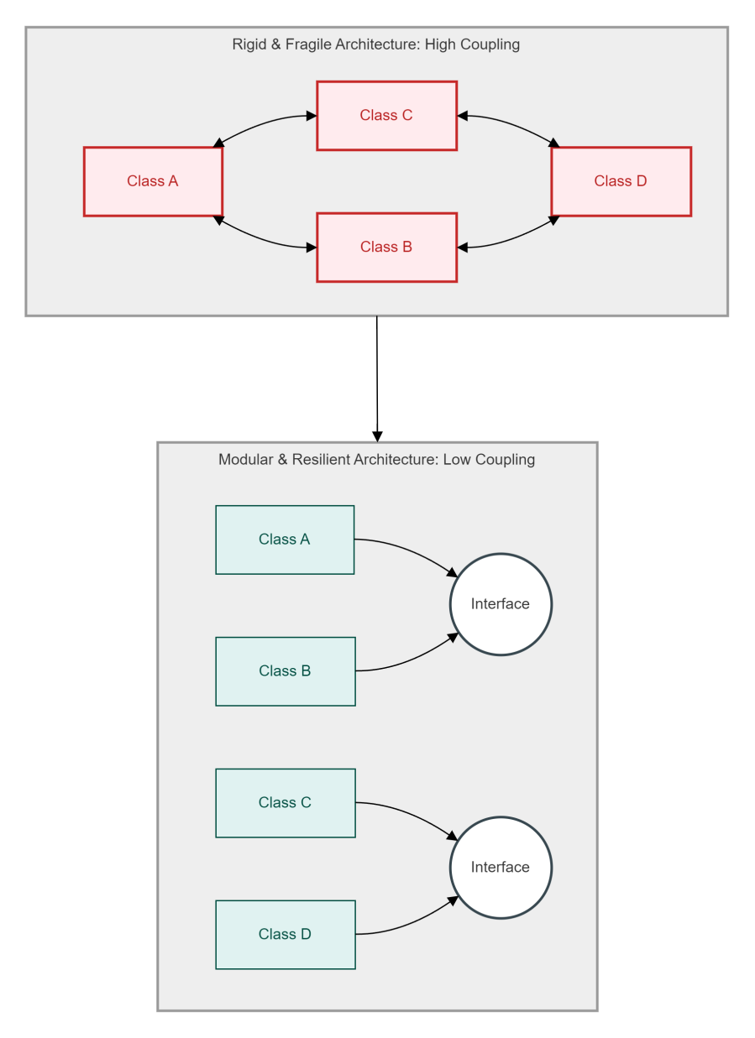
Structural Code Failures
The Reality of Rigidity:
Rigidity occurs when a codebase becomes entirely stiff and heavily resists everyday updates or logic modifications.
When an engineer attempts to execute a simple feature change in one localized file, it triggers a ripple effect, forcing manual code rewrites across multiple dependent modules.
This design failure severely damages development velocity because minor tasks require hours or days of unnecessary, exhausting refactoring.
The Threat of Fragility:
Fragility describes a highly unstable production system that fractures easily whenever code modifications are deployed.
When a small, isolated bug patch is applied to a single component, it unexpectedly disables completely unrelated functional areas deep inside the platform layout.
This forces engineering teams into a defensive position where they feel like they are constantly walking on eggshells during every release window.
The High Coupling Cascade:
High coupling represents the structural architectural failure that acts as the direct root cause behind both rigidity and fragility.
This degradation takes place when concrete objects or classes contain intimate, hardcoded dependencies regarding the internal mechanics of neighboring components.
Instead of functioning like loose, interchangeable Lego blocks that support clean upgrades, the system modules operate as an inseparable, permanently glued mass.

Slide 9
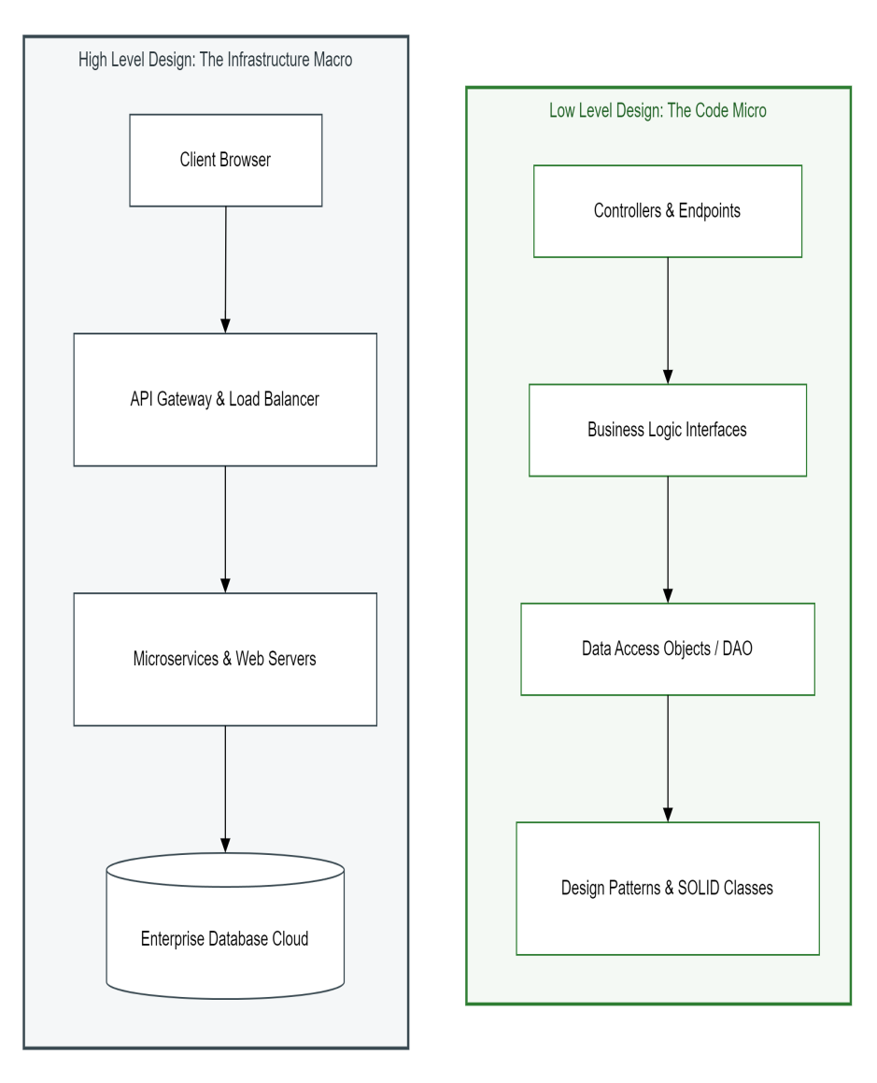
System Boundaries – HLD vs. LLD
The Macro Architecture vs. Micro Component Boundary:
High Level Design (HLD) acts as the comprehensive macro map of the system, defining where major infrastructure assets sit across the network topology.
Low Level Design (LLD) serves as the precise logical blueprint of an individual code module, outlining class interactions and code Level component relationships.
Establishing a clear, distinct boundary between these two domains ensures infrastructure scaling decisions remain decoupled from day to day code modifications.
Infrastructure Topology & Global Routing Data (HLD):
Dictates the macro level engineering environment, including the selection of enterprise relational or non relational database engines.
Establishes load balancing algorithms, API gateway ingress controls, cloud server cluster configurations, and physical data center routing strategies.
Manages how independent software systems, external microservices, and third party APIs transmit massive data streams across the network layer safely.
Component-Level Mechanics & Code Governance (LLD):
Operates entirely at the micro level, defining exactly how software engineers write clean, maintainable object-oriented programming files.
Establishes the exact communication boundaries between concrete classes, public interfaces, abstractions, and data transfer objects.
Enforces strict object oriented design patterns and creational strategies, allowing specific code modules to accept new business features without risking system crashes.
The Interdependency Threshold & System Viability:
High Level Design provides the scalable hosting environment to process user requests, while Low Level Design ensures code remains financially maintainable over time.
Without robust LLD governance, code complexity grows exponentially, eventually leading to cascading software decay that halts new software features entirely.
Even if a company invests in highly expensive cloud server architectures, the overall platform will crash if the underlying code is allowed to rot into an unmanageable mess.

Slide 10
Phase 2
The Foundational Layer (The OOP to SOLID Transition)

Slide 11
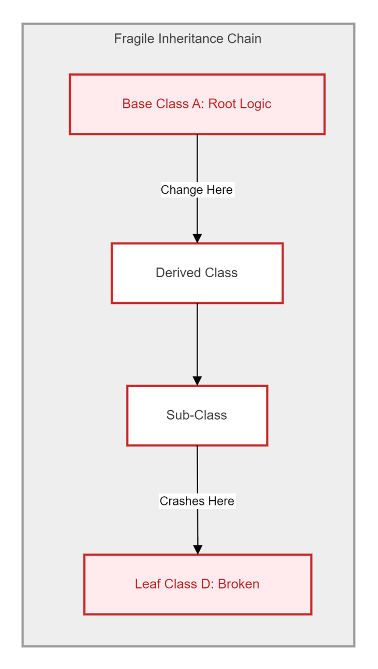
The Paradox of OOP
The Trap (The Semantic Misuse of Inheritance)
The Misconception of Code Reuse: Most developers mistakenly use Inheritance as a shortcut for code reuse rather than representing a strict, logical "IS-A" relationship.
Implementation Binding: This binds the child class to the physical implementation details of the parent, violating the principle of local reasoning.
Architectural Stagnation: Because the subclass is now a slave to the parent’s logic, the system loses the ability to evolve components independently.
The Problem (The Fragile Base Class Cascade)
Deep Hierarchy Vulnerability: Creating deep inheritance trees (Parent > Child > Grandchild) introduces the "Fragile Base Class" problem into the architecture.
The Ripple Effect: A minor, seemingly safe modification in the root "Parent" class triggers a destructive regression cascade through dozens of descendant classes.
The Birth of Rigidity: This is precisely how Rigidity is born; engineers become afraid to touch core classes because they cannot predict which "Leaf" classes will crash.
Encapsulation Failure (The Getter/Setter Anti-Pattern)
Pseudo Encapsulation: Simply hiding variables but providing public "Getters" and "Setters" for everything is not true encapsulation, it is a data leak.
Anemic Domain Models: This creates "Dumb Data Classes" where logic is separated from data, allowing external modules to bind directly to internal structures.
Loss of Integrity: Every external class becomes dependent on the internal state of the object, making it impossible to change the data structure without breaking the entire system.

Slide 12
Design Smells
The Concept of Architectural Design Smells:
A design smell is not an active execution bug or a production compiler error. Instead, it represents a structural symptom indicating that the underlying architecture is actively rotting.
It acts as an early warning metric for software engineers, signaling that while the system currently passes its tests, future logic updates will become drastically harder to implement safely.
Inelasticity (Structural Rigidity & Resistance to Change):
Inelasticity occurs when a codebase becomes entirely stiff and fails to bend or adapt gracefully to changing software requirements.
When a developer attempts to stretch the current system framework to integrate a new business feature, the rigid dependency links snap, creating critical regression errors.
Immobility (The Inability to Reuse System Modules):
Immobility describes a failure state where a highly valuable module, such as a "Login" or "Authentication" component, cannot be shared or reused in a separate company project.
Because the module is tightly glued to local database configurations and specific logging engines, reusing it requires copy pasting massive chunks of irrelevant, bloated infrastructure logic alongside it.
Viscosity (The Path of Least Resistance vs. Design Governance):
Viscosity measures how difficult it is for a software engineer to do the right thing versus executing a dangerous shortcut.
When a system exhibits high viscosity, it is physically easier and faster for a developer to implement a sloppy, hacky fix than it is to preserve and follow the formal, clean architectural patterns.

Slide 13
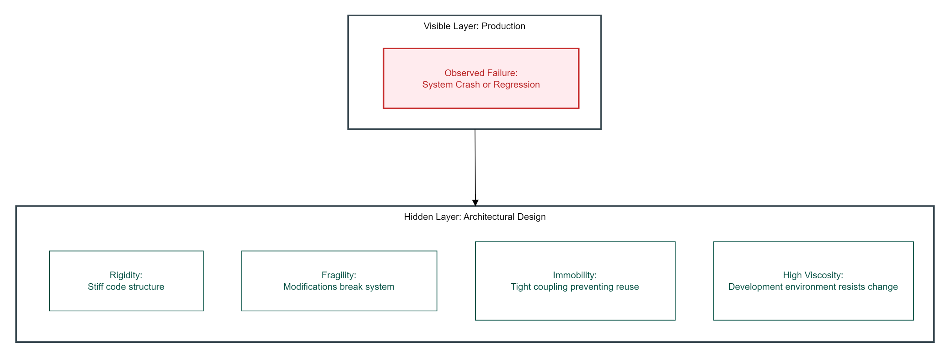

Slide 14
Phase 3
The SOLID Engineering Framework

Slide 15
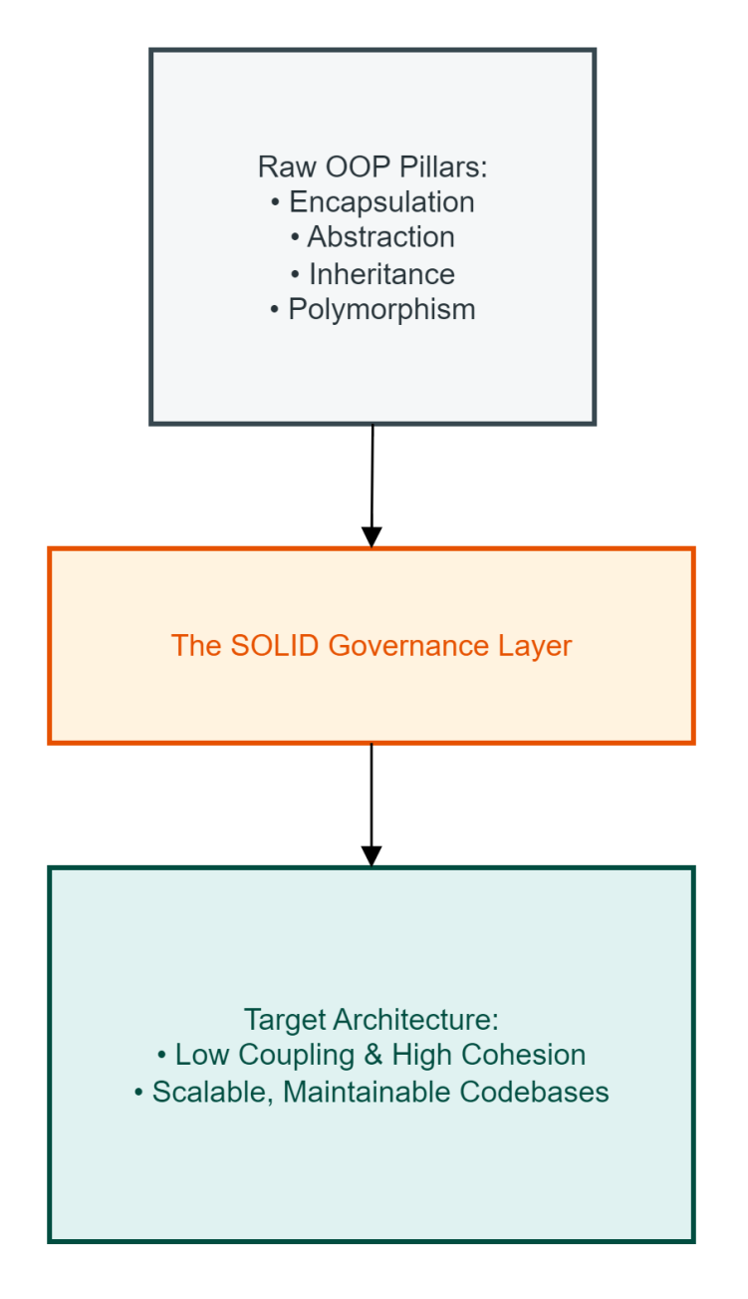
Introduction to SOLID Principles
The Architectural Evolution (Component Governance):
Basic Object-Oriented Programming (OOP) only offers elementary structural components like Classes, Interfaces, Polymorphism, and Encapsulation.
Crucially, raw OOP provides no standard governance rules on how to assemble these components safely; SOLID provides that necessary governance framework.
The Core Architectural Objective:
The primary objective of the SOLID framework is to structurally limit the blast radius of day-to-day software code modifications.
Implementing these patterns ensures that a feature update or bug patch made to one localized system module never ripples outward to break completely unrelated features.
The Return-on-Investment (ROI) Stability Curve:
Ungoverned software suffers from an exponential cost-of-change curve, meaning updates become drastically slower and more expensive over the lifecycle.
Adhering to SOLID straightens this trajectory into a predictable, linear pace, protecting long-term development velocity.

Slide 16
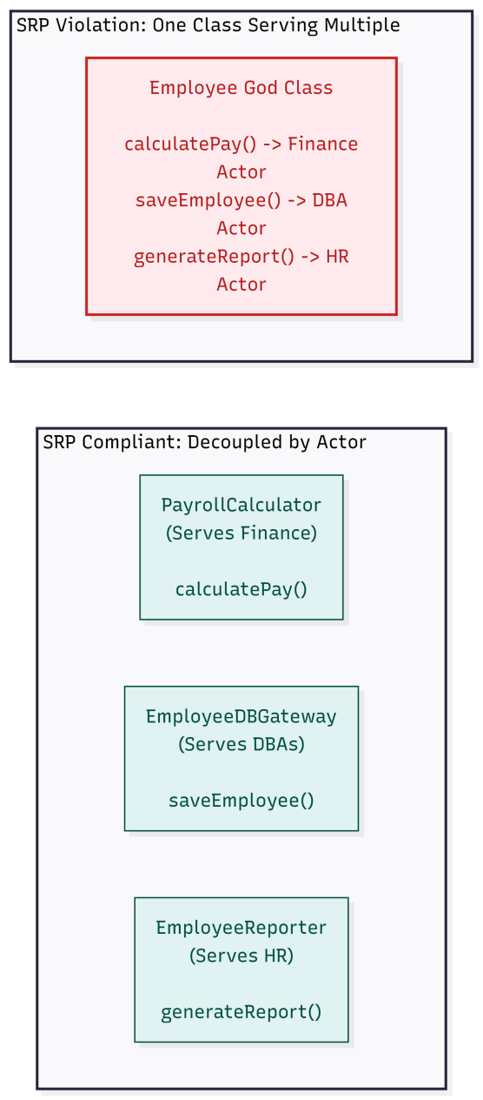
Single Responsibility Principle
The Formal Definition:
Actor-Driven Responsibility: Robert C. Martin (Uncle Bob) defines SRP strictly around business stakeholders: "A module should be responsible to one, and only one, actor."
Defining the Actor: An actor represents a specific group of stakeholders (such as Finance, HR, or DBAs) who possess unique business requirements and can independently request a code change.
Reason for Change:
The Single Pivot Metric: SRP is not about a class performing only "one functional task." It dictates that a class must possess a single, isolated reason to change.
The Multi-Actor Violation: If a single class serves multiple actors simultaneously, it creates a severe architectural violation, tying independent business workflows to the same file.
The Benefit:
Maximizing High Cohesion: Isolating distinct responsibilities into separate classes creates highly cohesive modules that are simpler to maintain.
Blast Radius Protection: This decoupling prevents a change requested by the Finance department (like updating a tax calculation) from accidentally breaking completely unrelated reporting code used by the HR department.

Slide 17
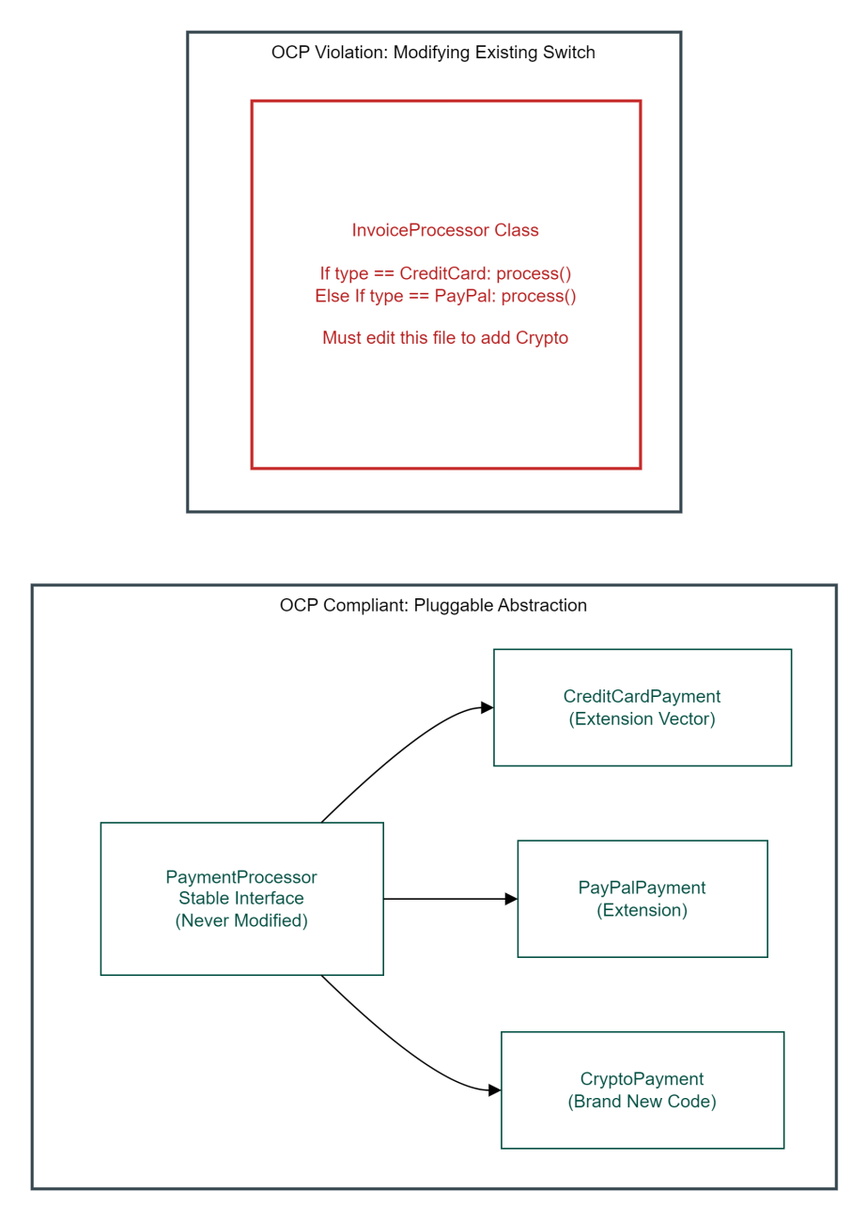
Open/Closed Principle
The Core Definition:
Meyer's Architectural Axiom: Bertrand Meyer defines OCP stating that software entities like classes, modules, and functions must be open for extension, but closed for modification.
The Stability Goal: This foundational concept ensures that core system features remain completely stable and trusted while allowing the application to support new business requirements over time.
Closed for Modification:
Production Integrity Enforcements: Once a core class is written, unit-tested, and compiled into production, its existing codebase should never be touched or altered to implement a new feature.
Regression Protection: Lock down existing code mechanics to insulate tested, operational business logic from the accidental introduction of unexpected regression defects.
Open for Extension:
Scale Through Addition: Introduce new system behaviors and features exclusively by creating new subclasses or implementing existing interfaces.
The New Code Metric: Scale system capabilities dynamically by writing entirely new isolated files, completely eliminating the need to rewrite or alter old existing code blocks.
The Architectural Mechanism:
Polymorphic Inversion: This pattern relies entirely on core Polymorphism and Abstraction Layers to decouple the execution flow cleanly.
Stable Contracts: The calling context depends exclusively on a stable public interface contract, allowing brand-new implementation features to plug directly into that interface layer seamlessly.

Slide 18
Liskov Substitution Principle
The Formal Definition:
Subtype Substitutability: Barbara Liskov defines it as: "Subtypes must be substitutable for their base types without altering the correctness of the program."
The Core Requirement: A client program must be able to pass any subclass variant into a function without knowing its specific implementation type and without causing a crash.
The Behavioral Contract:
Honoring Parent Behavior: Inheriting from a parent class means you must honor behavioral expectations. A subclass cannot arbitrarily choose to reject or break a method inherited from its parent.
The Failure State (Subtype Volatility):
Runtime Exceptions: If a subclass throws an unexpected runtime error (like an UnsupportedOperationException) for an inherited method, it breaks the parent's contract.
The Client Breakage: The client expects the inherited behavior to execute smoothly. Forcing it to deal with a broken implementation means LSP is violated.
The Classic Bird Violation (The Ostrich Dilemma):
The Flawed Assumption: Assuming all birds can fly leads to putting a fly() method in a generic Bird Base Class.
The Contract Breach: When an Ostrich Subclass inherits from that base class, it cannot behaviorally implement fly(). It is forced to throw a runtime error, breaking the expectations of any module handling generic birds.

Slide 19
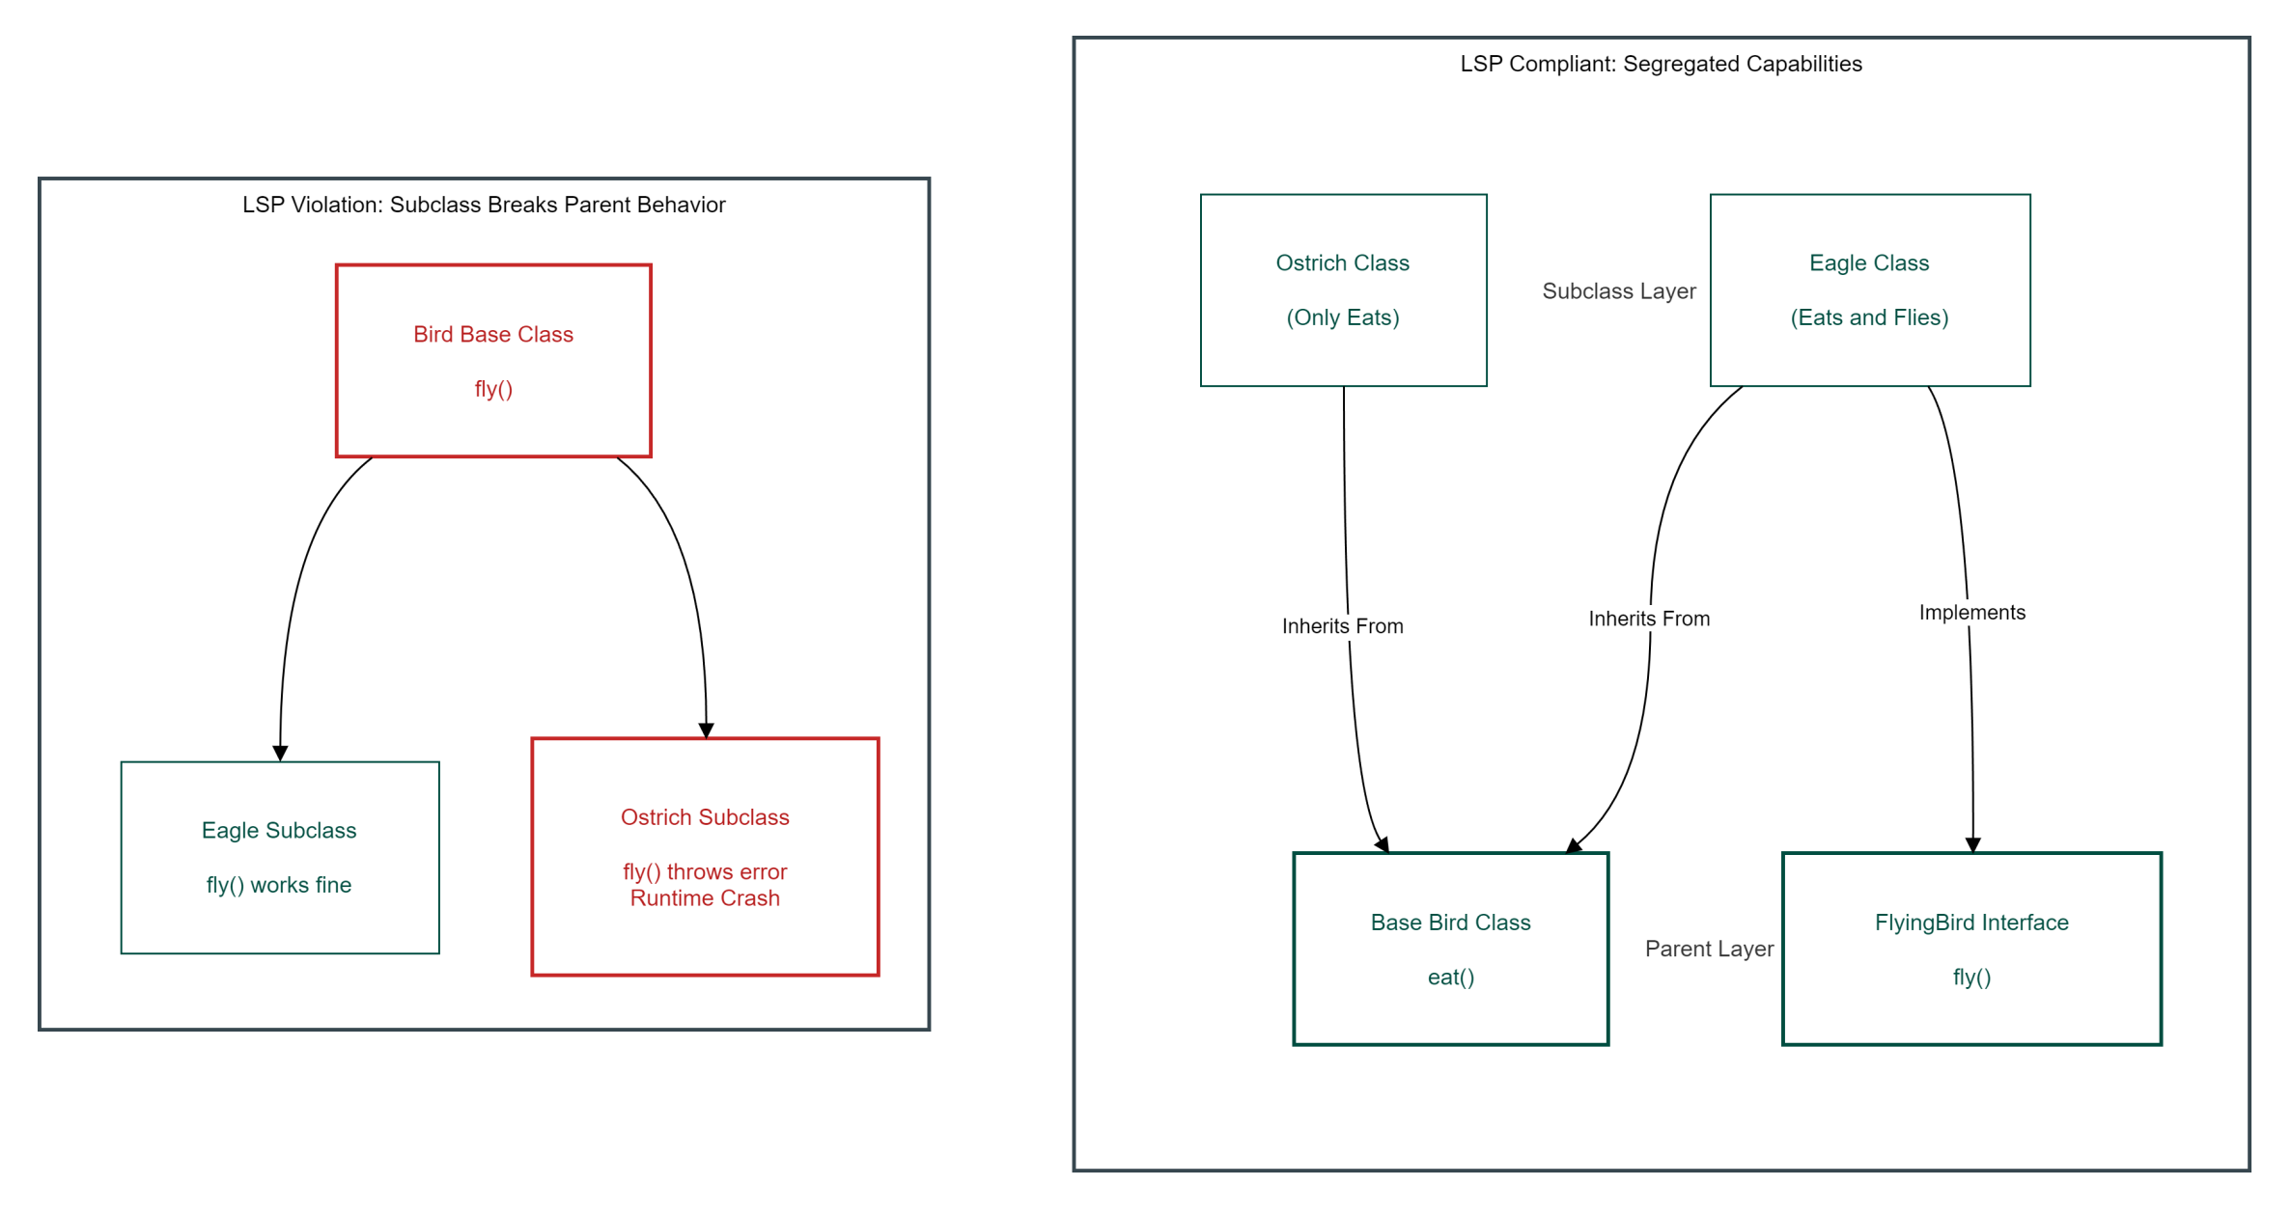

Slide 20
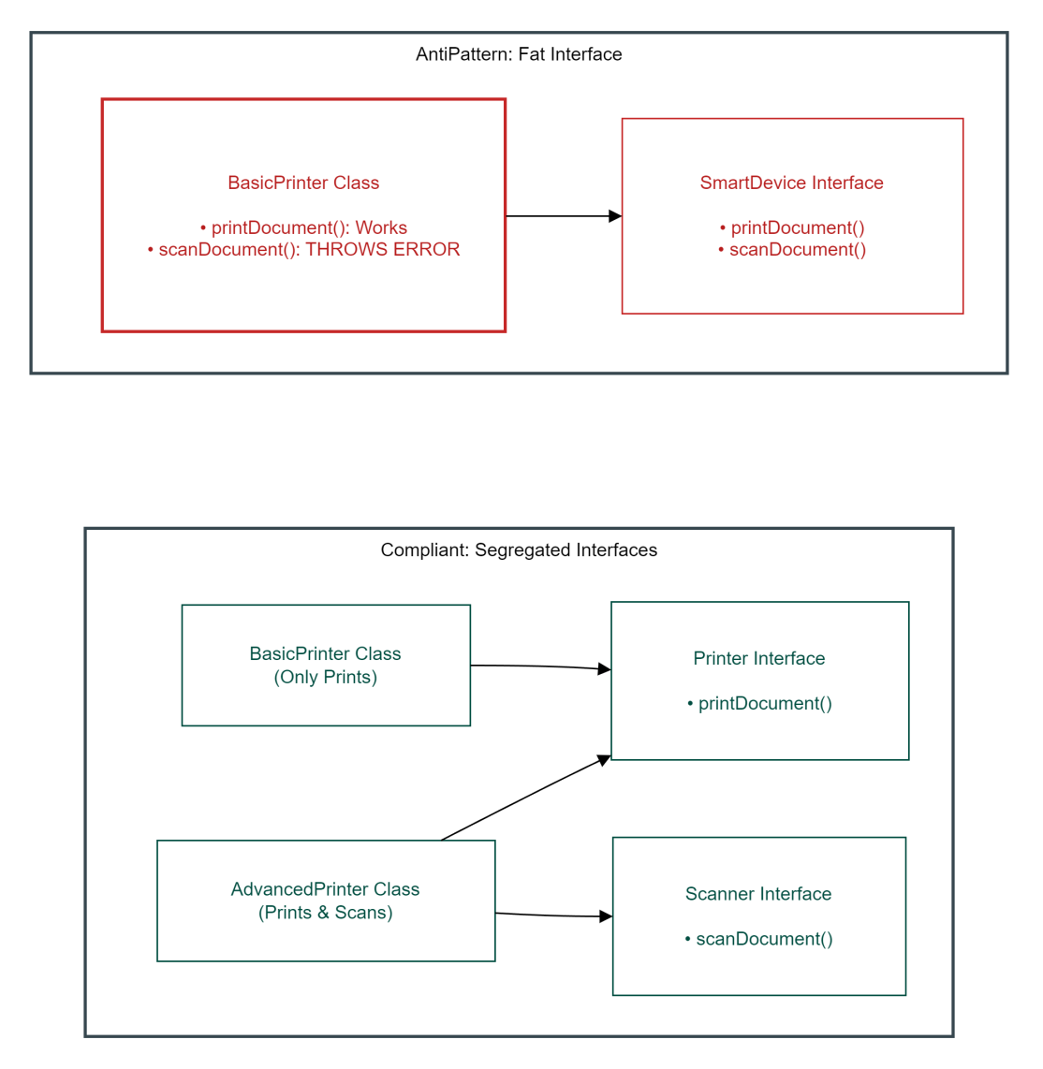
Interface Segregation Principle
The Core Definition:
The Client-Centric Rule: "Clients should not be forced to depend upon interfaces that they do not use."
Eliminating Bloat: This principle focuses on designing thin, role-specific interfaces rather than forcing implementing classes to inherit behavior they do not require.
The Problem (Fat Interfaces):
Monolithic Abstractions: When an interface grows too large, it accumulates methods that serve completely different client requirements.
Boilerplate Pollution: Any class implementing a "fat interface" is forced to write useless boilerplate implementations, often throwing a runtime NotImplementedException or returning null for unsupported operations.
The Structural Harm:
Compile-Time Coupling: Fat interfaces create unnecessary compile-time dependencies across the system architecture.
The Recompilation Cascade: If you modify a single method header used only by Client A, every single other client class in the codebase is forced to recompile, completely destroying component isolation.
The Solution:
Role-Based Segregation: Split fat interfaces into small, highly cohesive, specialized contracts based on the client's actual usage domain.
Decoupled Architecture: Classes should implement multiple small interfaces instead of one giant interface, ensuring changes to one capability never ripple into an unrelated system module.

Slide 21
Dependency Inversion Principle
The Core Definition:
Martin's Decoupling Mandate: Robert C. Martin dictates two structural laws for DIP: High-level modules must not depend on low-level modules; both must depend strictly on abstractions.
Detail Independence: Abstractions must never depend on volatile concrete details. Instead, low-level concrete details must depend entirely upon stable, high-level abstractions.
The Traditional Flow of Control (The Trap):
The Hardcoding Vulnerability: In traditional procedural or unmanaged object-oriented code, high-level business policy classes directly instantiate low-level utility components.
Structural Fragility: Directly hardcoding a production dependency—such as locking a NotificationService to a specific MySQLDatabase instance—renders core business logic fragile and vulnerable to downstream infrastructural changes.
Inverting the Dependency:
Bypassing Direct Links: Inserting an explicit Abstraction Layer (Interface) between components completely breaks the rigid compile-time coupling.
Inverting System Control: The high-level policy module assumes complete control over the shape, signature, and contract of the interface, forcing all low-level operational modules to conform to it.
The Architectural Value:
Establishing Pluggability: This inversion establishes a highly modular, pluggable application architecture across the enterprise.
Insulating Core Logic: Engineering teams can cleanly hot-swap underlying databases, switch third-party communication APIs, or replace logging frameworks without modifying a single line of core business policy logic.

Slide 22
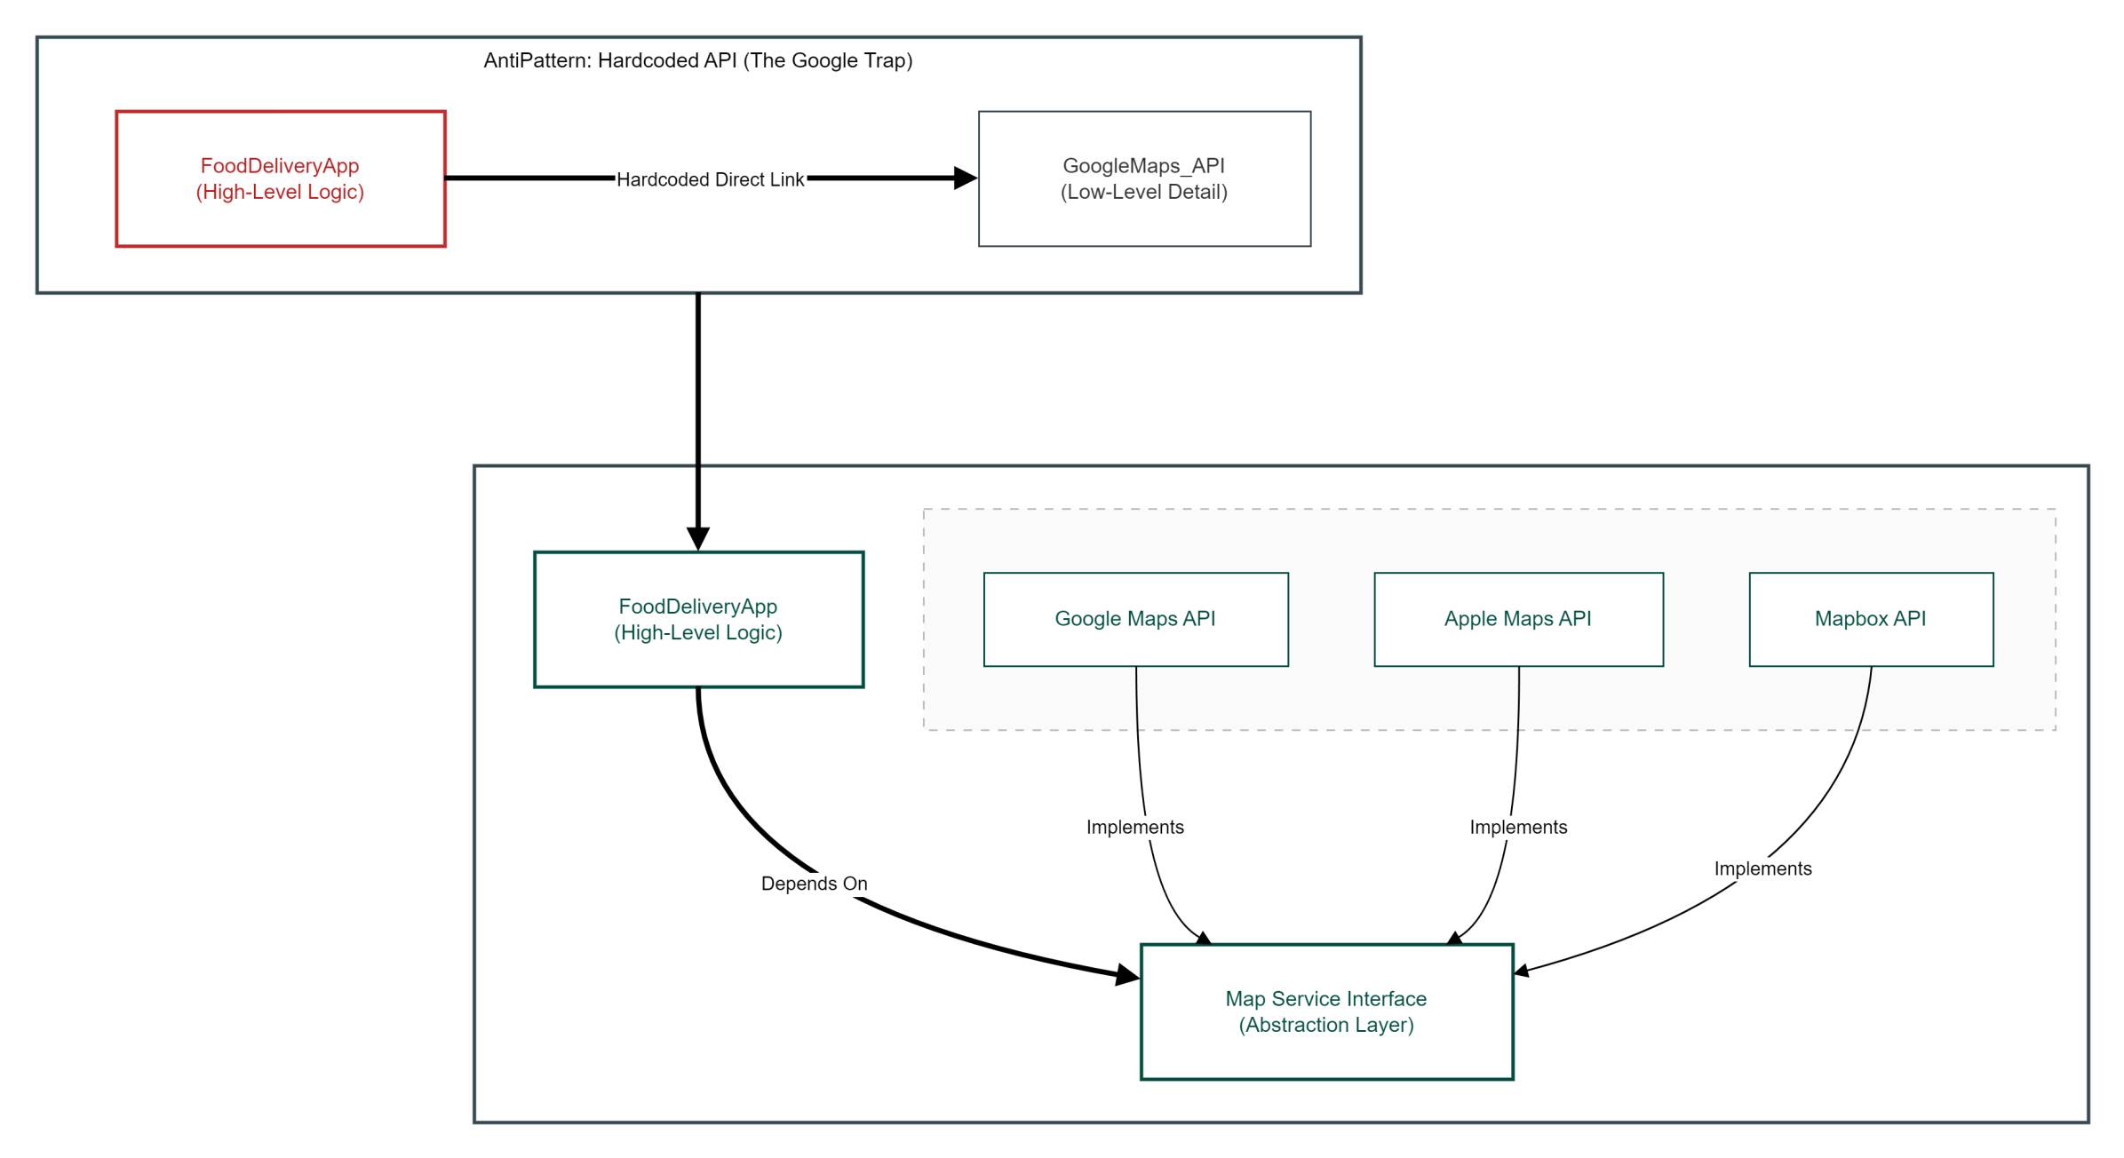

Slide 23
Phase 4
Design Patterns & Real World Validation

Slide 24
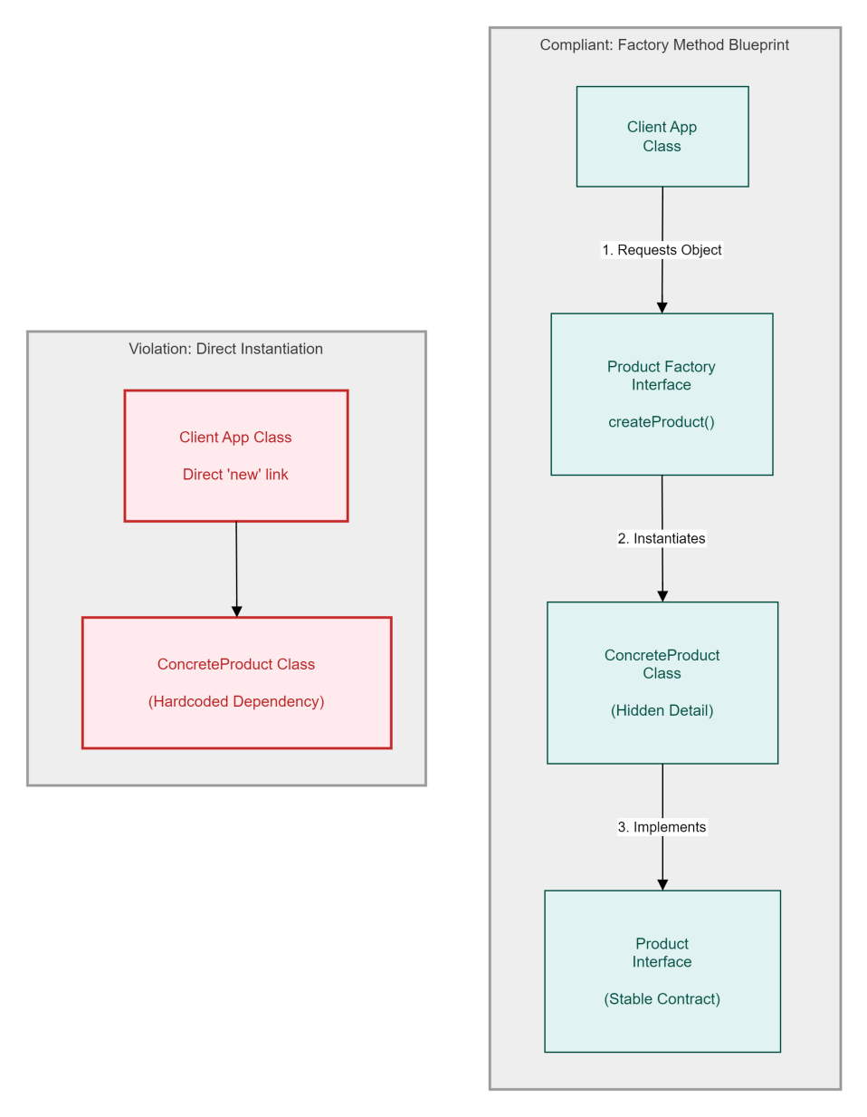
Creational Blueprints
The Problem (The 'new' Keyword Violation):
When you use the new keyword to instantiate a concrete subclass directly inside a client class, you break the Dependency Inversion Principle (DIP).
This direct instantiation tightly couples high-level modules to low-level implementation details, making it impossible to swap out components cleanly.
The Factory Remedy:
The Factory Method Pattern decouples object creation by abstracting the instantiation process away from the client class.
Client code only interacts with a generic, stable interface, while a dedicated factory subclass encapsulates and handles the actual concrete object creation behind the scenes.
The Operational Value:
To introduce a brand-new concrete type to the system, you simply write a new class file and plug it into the factory structure.
The existing client code remains completely untouched and closed for modification, satisfying the Open/Closed Principle (OCP) while scaling application features.

Slide 25
Behavioral Blueprints
The Problem (The Open/Closed Violation):
When runtime behavioral algorithms are hardcoded inside massive conditional blocks (if-else or switch statements), the system architecture becomes brittle.
Adding a new business rule forces you to modify the existing host class, violating the Open/Closed Principle (OCP) and risking regression bugs in stable production code.
The Strategy Remedy (Polymorphic Delegation):
The Strategy Pattern defines a family of algorithms, encapsulates each one inside its own dedicated class configuration, and makes them fully interchangeable.
By shifting logic from hardcoded switch-cases into independent strategy classes, the system relies on a shared interface contract to delegate execution at runtime.
The Operational Value (Zero-Modification Scaling):
The host execution context remains entirely decoupled from specific runtime implementation variants.
To add a brand-new algorithm or business rule, you simply create a new strategy class without rewriting a single line of your core logic (OCP), ensuring seamless horizontal scalability.

Slide 26
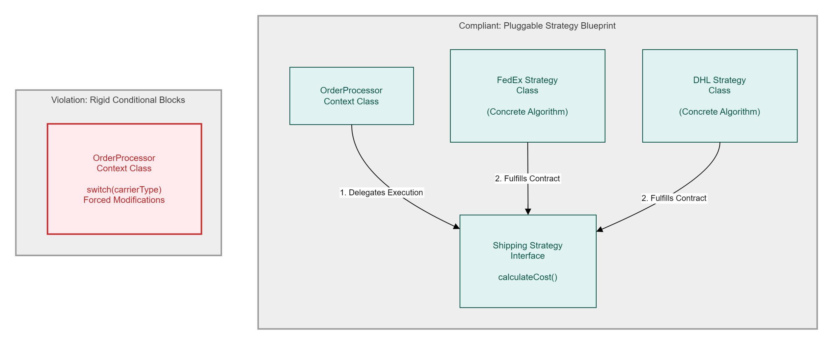

Slide 27
Enterprise Case Studies
The Industrial Transition:
From Academic to Enterprise: This phase represents the critical shift from single-file academic code submissions toward professional, modular architectures designed for multi-year lifecycles.
Architecture for Longevity: Professional engineering prioritizes "Infrastructural Agility," ensuring that the codebase can survive shifts in technology stacks, team rotations, and evolving business requirements.
Quantifiable Maintenance ROI:
Reducing Technical Entropy: Real-world software metrics confirm that wrapping tightly coupled legacy systems in SOLID-compliant boundaries can reduce downstream maintenance overhead and bug density by up to 60%.
The Cost of Rigidity: By isolating volatile components, enterprises avoid the "Refactoring Debt" that typically consumes 70% of an average IT department's budget.
The Hybrid Migration Strategy:
Isolating Technical Debt: Avoid high-risk, full-system rewrites that often lead to project failure. Instead, stabilize production platforms by deploying specialized Adapter and Facade patterns.
Legacy Encapsulation: These patterns act as a "protective layer," isolating legacy technical debt behind stable, modern interfaces, allowing new features to be built with clean, decoupled logic while the old system continues to run.

Slide 28
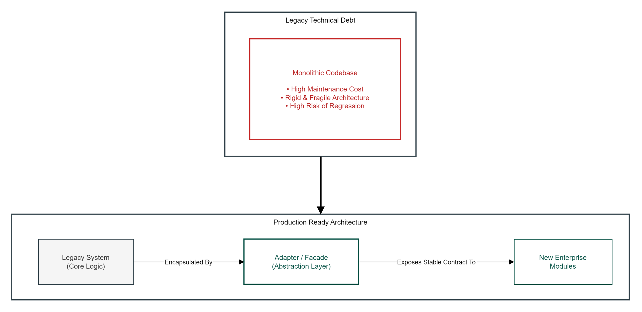

Slide 29
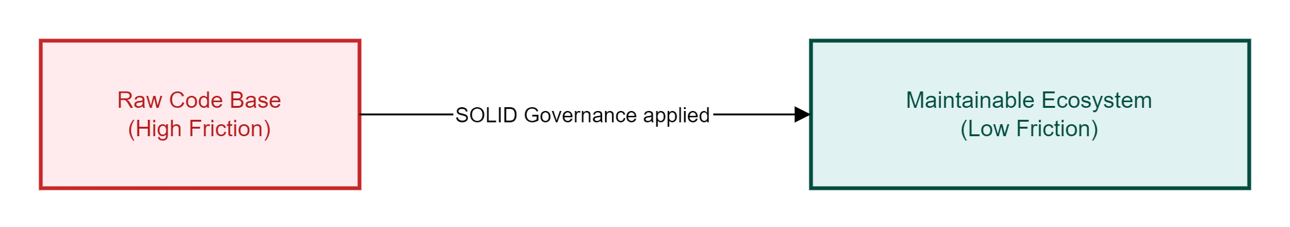
Seminar Synthesis
The Architectural Shift:
Deterministic Design: SOLID design principles systematically turn unpredictable, fragile codebases into deterministic, highly adaptive enterprise software environments.
The Governance Layer:
Non-Negotiable Rules: Software design principles are not optional stylistic choices; they are crucial engineering laws required to control the long-term compounding cost of code changes.
The Final Takeaway:
Clean Boundaries: Clean architecture separates core high-level business rules from volatile low-level implementation details.
The Continuous Growth Metric: This separation guarantees that software remains open for business scaling and rapid feature growth, but strictly closed to unexpected regression failures.

Slide 30
Thank You
Engineering Scalable Systems: The Core Principles of LLD and SOLID
Prabhu Teja Pamula | 24EMCA1237

